Slide 1
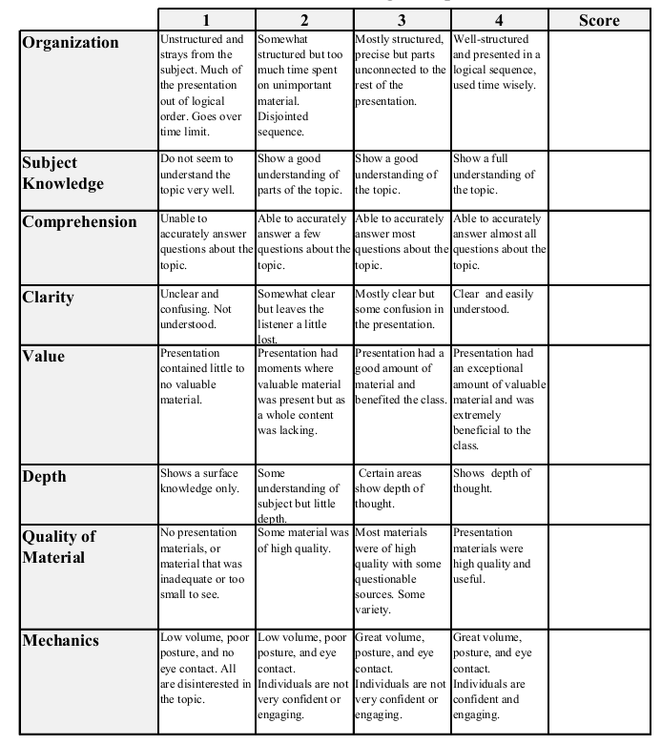
Fall 2013: Econ 339 Final Presentation
Eric Millbrook
December 9, 2014
The long-term cognitive consequences of early childhood malnutrition
Reference: S.K. Ampaabeng, C.M. Tan (2013), Journal of Health Economics, vol. 32, p.1013– 1027
Total:_________

Slide 2
Hurdles to Data Collection
Cannot purposefully starve children
Control groups from populations that are different
Time lapse between natural observations
Long term effects recurring in later generations

Slide 3
The Model
The model used to estimate cognitive ability is:
CA_{i,t} = α + μ_{t} + δ₀DRD_{l,1983} + δ ₁(t + DRD_{l,1983} * t) + x’_{i,t}β + ε_{i,t}
Where: CA = Cognitive ability of individual i at time t
α = Constant
DRD = Death Rate Deviation (severity of the famine)
t = 0,1 (either age 3-8 or 0-2 during famine, respectively)
x’_{i,t} = other variables that might affect CA
n = 611

Slide 4
How is CA Measured?
Using Raven’s Progressive Matrices test.
Using standardized math and English tests, in two waves:
First, an extremely basic test.
Second, for those that got 50% or better on the basic test, a much harder test matching what students in western nations’ schools might encounter.

Slide 5
What is Death Rate Deviation?
The difference between the Under Five Mortality Rates in the years 1983-84 (famine years) and the mean for the years 1985-87.
Weighted by the Rain Deviation for the individual’s area from ‘83-’84 and ‘85-’91.
Objective: A variable that identifies the severity of the famine in the years it occurred for the individuals sampled.

Slide 6
Variables for which the Data was Controlled
Age of survey respondents in 2003
School Quality, with an indicator variable, and information on classroom usability and text book availability
Years of Schooling by 2003
Household size (which might affect hunger if there was competition for food)
Total schooling of parents
Locality (urban or rural)

Slide 7
Independent Variables | Kitchen Sink Model |  | Robustness Test |  | Dropped insignificant variables |  | Separated 3-8 cohort into 3-5 and 6-8
Height | 1.7943*** | 1.7055*** | 2.8218*** | 2.8502*** | 2.9682*** | 2.9405*** | 3.1176*** | 3.1002***
 | (0.3876) | (0.3701) | (0.7258) | (0.7051) | (0.6467) | (0.6362) | (0.7133) | (0.6975)
PrimarySchool | 5.9637 | 6.7699* | 1.0087 | 2.1886 | 3.9253*** | 3.8939*** | 2.4332 | 3.9411
 | (3.7135) | (3.5397) | (10.6826) | (10.6219) | (0.7234) | (0.7141) | (9.7543) | (9.6654)
ParentalSchooling | 0.1274*** | 0.1198** | – | – | 0.1130*** | 0.1121*** | 0.0940** | 0.0977**
 | (0.0441) | (0.0421) | – | – | (0.0404) | (0.0401) | (0.0421) | (0.0416)
HouseholdSize(1983) | 0.3254* | 0.3356* | 0.2572* | 0.2634* | 0.3446** | 0.3415** | 0.3423** | 0.3509**
 | (0.1797) | (0.1715) | (0.1484) | (0.1494) | (0.1342) | (0.1335) | (0.1399) | (0.1424)
Urban | 2.9655*** | 2.6242*** | 1.8743** | 1.8866** | 3.3956*** | 3.3815*** | 1.6266** | 1.6043**
 | (0.7326) | (0.6992) | (0.7488) | (0.7350) | (0.6748) | (0.6670) | (0.7160) | (0.7034)
Distance To District Capital | -0.5203 | -0.536* | -0.6137** | -0.6332** | -0.5196* | -0.5196** | -0.6068** | -0.6357**
 | (0.3183) | (0.3035) | (0.2868) | (0.2785) | (0.2653) | (0.2627) | (0.2774) | (0.2686)

Slide 8
Independent Variables | Kitchen Sink Model |  | Robustness Test |  | Dropped insig vars |  | separated 3-8 cohort into 3-5 and 6-8
Death deviation 1983* age0–2 during famine | -29.2343** | -22.8503 | -29.5333* | -18.3219 | -29.4745** | -29.183 | -34.3442** | -23.5185
 | (14.7375) | (21.0380) | (15.5090) | (23.1465) | (13.1188) | (19.8733) | (16.2882) | (24.0066)
Death deviation 1983× age3–5 during famine | – | – | – | – | – | – | (13.0986) | (28.8882)
 | – | – | – | –– | – | – | (19.2213) | (27.1732)
Rain fall deviation 1983 | – | -0.005*** | – | -0.0048*** | – | -0.0055*** | – | -0.0049***
 | – | (0.0004) | – | (0.0004) | – | (0.0003) | – | (-0.0043)
Rain fall deviation 1983* age0–2 during famine | – | -0.0042*** | – | -0.0043*** | – | -0.0043*** | – | -0.0043***
 | – | (0.0004) | – | (0.0004) | – | (0.0004) | – | (0.0004)
Rain fall deviation 1983× age3–5 during famine | – | – | – | – | – | – | – | -0.0042***
 | – | – | – | – | – | – | – | (0.0006)
N | 557 | 557 | 557 | 557 | 587 | 587 | 557 | 557
R-squared | 0.28 | 0.28 | 0.28 | 0.27 | 0.25 | 0.25 | 0.27 | 0.27
F-statistic | 19.42 | – | 17.56 | – | 19.9 | – | 21.06 | –

Slide 9
Independent Variables that Matter
Schooling – Only years of schooling significantly impacted Cognitive Ability (CA). Quantity, not Quality.
Famine Intensity – More malnutrition = lower CA, a significant negative relationship. A 1 s.d. increase in famine intensity lead to the equivalent of 0.4-0.5 years of schooling lost.

Slide 10
What this Means in Monetary Terms
An extra year of schooling translates to an increase of 7% in that individuals financial return on schooling.
Therefore, the loss to the average famine afflicted child is 2.8% a year for their entire lives.
This added up to a 0.4% loss to Ghana’s GDP in 1997, when many of them started work.

Slide 11
What this Means for Policy
The inspiration for this study was a huge influx of support from the World Bank to improve Ghana’s education system over the 15 years following the famine.
This study implies that money went to waste; educational quality did not have a significant impact on cognitive ability after early nutrition and health status are accounted for.
Feeding the children ends up being more effective than educating them, in the long run.

